Slide 1
<number>
Simple Line Drawing
DDA (Digital Differential Analyzer)
Notes:
<number>

Slide 2
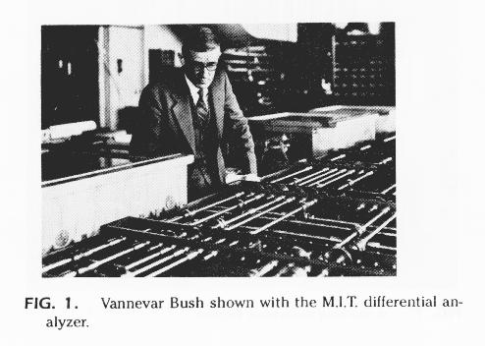
<number>
The digital differential analyser (DDA) algorithm takes an incremental approach in order to speed up scan conversion
Simply calculate yk+1 based on yk
The DDA Algorithm
The original differential analyser was a physical machine developed by Vannevar Bush at MIT in the 1930’s in order to solve ordinary differential equations.

Slide 3
<number>
Consider the list of points that we determined for the line in our previous example:
(2, 2), (3, 23/5), (4, 31/5), (5, 34/5), (6, 42/5), (7, 5)
Notice that as the x coordinates go up by one, the y coordinates simply go up by the slope of the line
This is the key insight in the DDA algorithm
The DDA Algorithm (cont…)

Slide 4
<number>
When the slope of the line is between -1 and 1 begin at the first point in the line and, by incrementing the x coordinate by 1, calculate the corresponding y coordinates as follows: (for jogl x+=.01)
When the slope is outside these limits, increment the y coordinate by 1 and calculate the corresponding x coordinates as follows: (for jogl y+=.01)
The DDA Algorithm (cont…)

Slide 5
<number>
Again the values calculated by the equations used by the DDA algorithm must be rounded to match pixel values (don’t round for jogl)
The DDA Algorithm (cont…)
(xk+1, round(yk+m))
(round(xk+ 1/m), yk+1)
(xk, yk)
(xk+ 1/m, yk+1)
(xk+1, yk+m)
(xk, yk)
(xk, round(yk))
(round(xk), yk)

